Slide 1
Data Source Controls
Do not need to write any data access code
(Note: In most professional, large-scale applications, you’ll still need to write and fine-tune your data access code for optimum performance, data aggregation, error handling, logging, and so on.)

Slide 2
Data source controls
Data source controls include any control that implements the IDataSource interface
  SqlDataSource
  ObjectDataSource
  AccessDataSource
  XmlDataSource
  SiteMapDataSource

Slide 3
Data source controls
Perform two key tasks
  retrieve data from a data source and supply it to linked controls
  update the data source when edits take place in linked controls

Slide 4
The Page Life Cycle with Data Binding
Data binding tasks take place in this order
The page object is created (based on the .aspx file).
The page life cycle begins, and the Page.Init and Page.Load events fire.
All other control events fire.
The data source controls perform any updates. If a row is being updated, the Updating and Updated events fire. If a row is being inserted, the Inserting and Inserted events fire. If a row is being deleted, the Deleting and Deleted events fire.
The Page.PreRender event fires.
The data source controls perform any queries and insert the retrieved data in the linked controls. The Selecting and Selected events fire at this point.
The page is rendered and disposed.

Slide 5
The SqlDataSource
.NET ships with these four provider factories
  System.Data.SqlClient
  System.Data.OracleClient
  System.Data.OleDb
  System.Data.Odbc
Responsibility of the factory
  For creating the provider specific objects that the SqlDataSource needs in order to access the data source
A SqlDataSource that connects to a SQL Server database:
  <asp:SqlDataSource ProviderName="System.Data.SqlClient" ... />

Slide 6
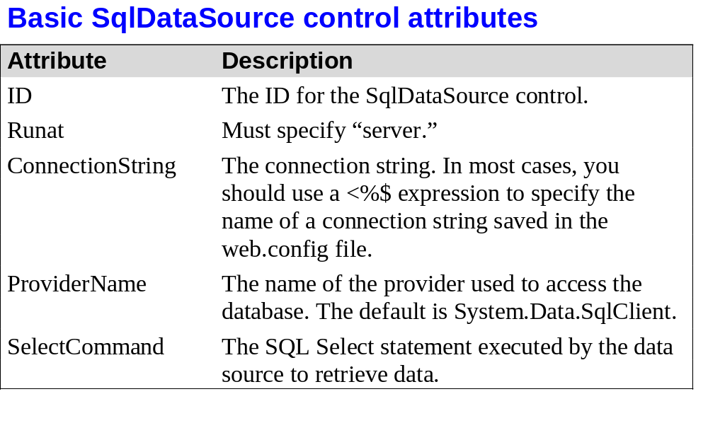
© 2011, Mike Murach & Associates, Inc.
Slide <number>

Slide 7
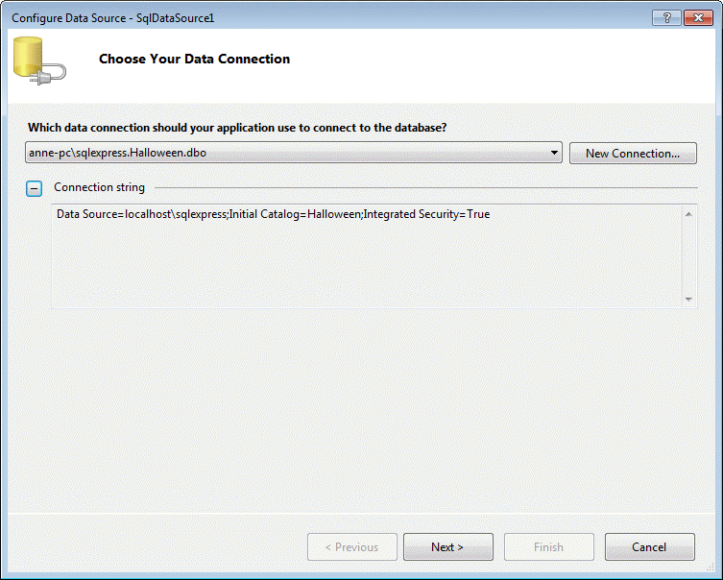
© 2011, Mike Murach & Associates, Inc.
Slide <number>

Slide 8
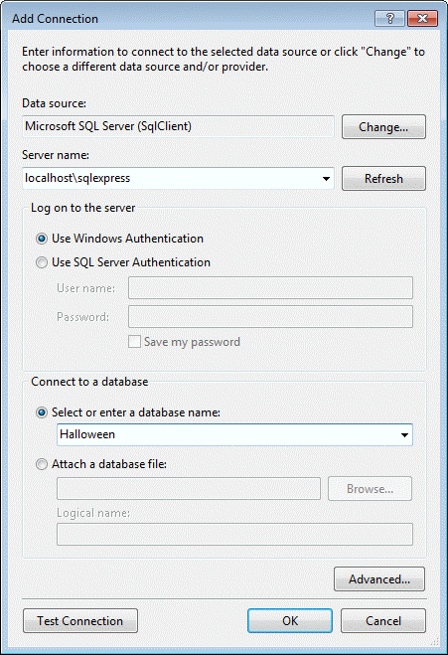
© 2011, Mike Murach & Associates, Inc.
Slide <number>

Slide 9

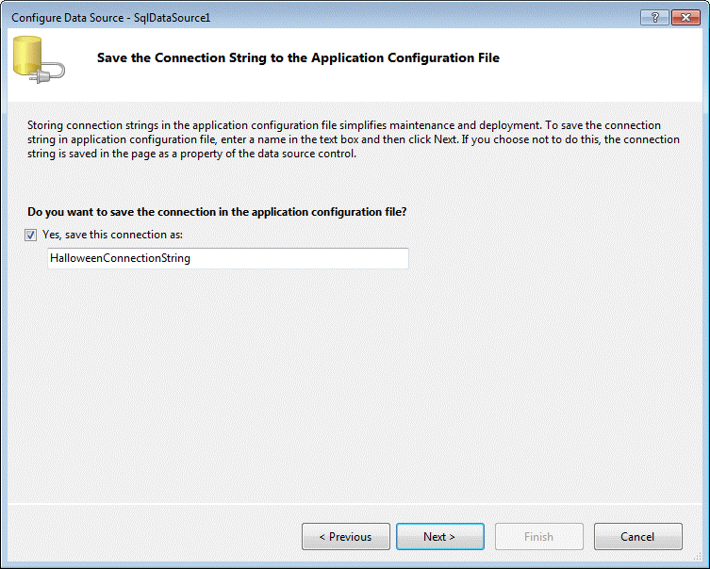
© 2011, Mike Murach & Associates, Inc.
Slide <number>

Slide 10
Supplying the required connection string
If the connection string is defined in Web.config
  <configuration>
  <connectionStrings>
  <add name="Northwind"
  connectionString="Data Source=localhost;Initial Catalog=Northwind;
  Integrated Security=SSPI"/>
  </connectionStrings>
  ...
  </configuration>

Slide 11
Supplying the required connection string
Use a $ expression to specify the connection string in SqlDataSource
  <asp:SqlDataSource ConnectionString="<%$ ConnectionStrings:Northwind %>" ... />

Slide 12
Selecting Records
SqlDataSource command logic is supplied through four properties: SelectCommand, InsertCommand, UpdateCommand, and DeleteCommand, each of which takes a string
The corresponding SelectCommandType, InsertCommandType, UpdateCommandType, or DeleteCommandType property should be Text
  Command type is StoredProcedure if the command is a stored procedure

Slide 13
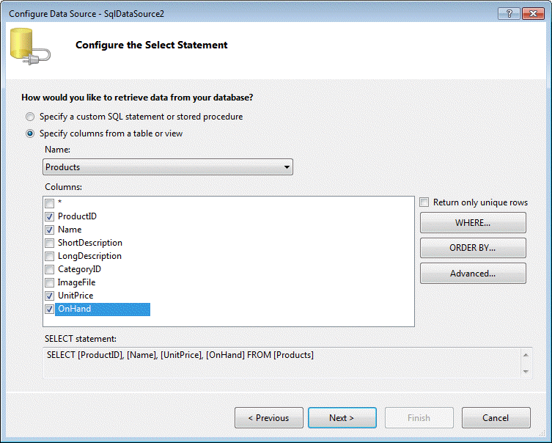
© 2011, Mike Murach & Associates, Inc.
Slide <number>

Slide 14
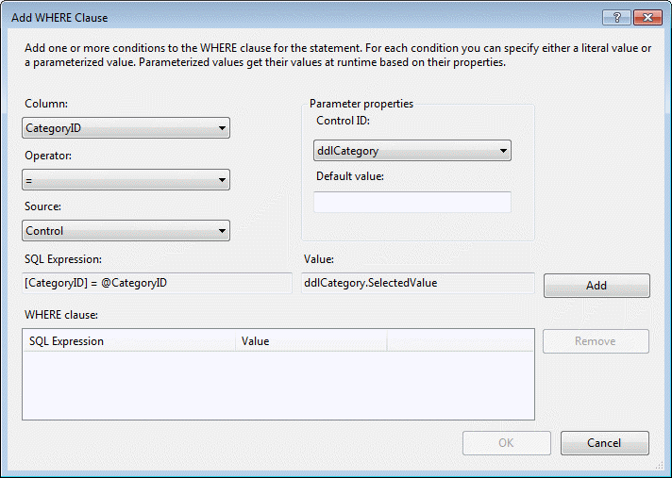
© 2011, Mike Murach & Associates, Inc.
Slide <number>

Slide 15

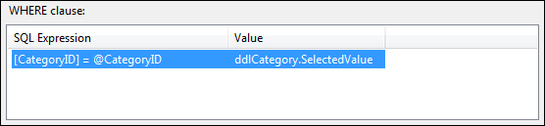
© 2011, Mike Murach & Associates, Inc.
Slide <number>

Slide 16

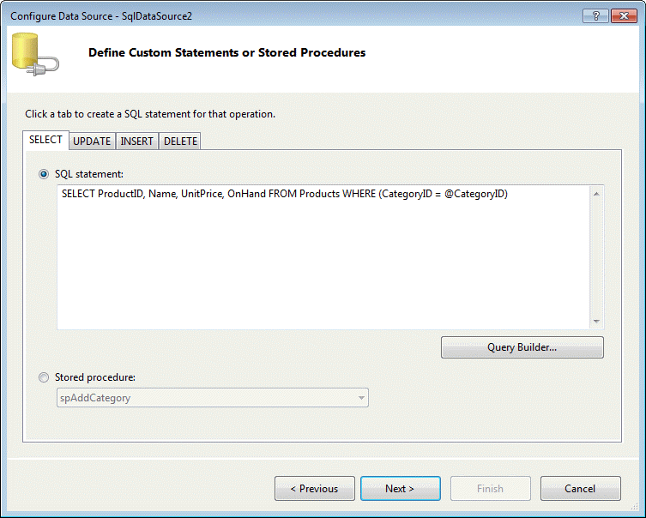
© 2011, Mike Murach & Associates, Inc.
Slide <number>

Slide 17
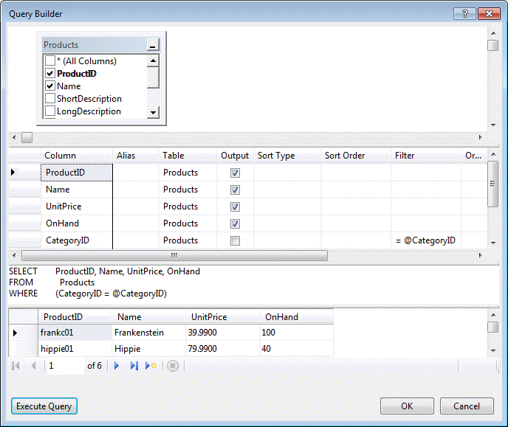
© 2011, Mike Murach & Associates, Inc.
Slide <number>

Slide 18
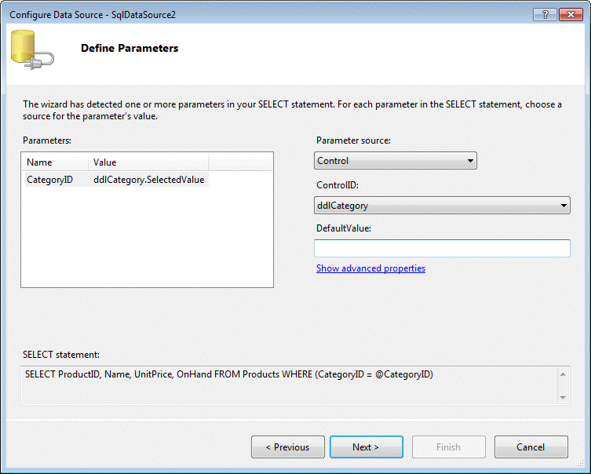
© 2011, Mike Murach & Associates, Inc.
Slide <number>

Slide 19
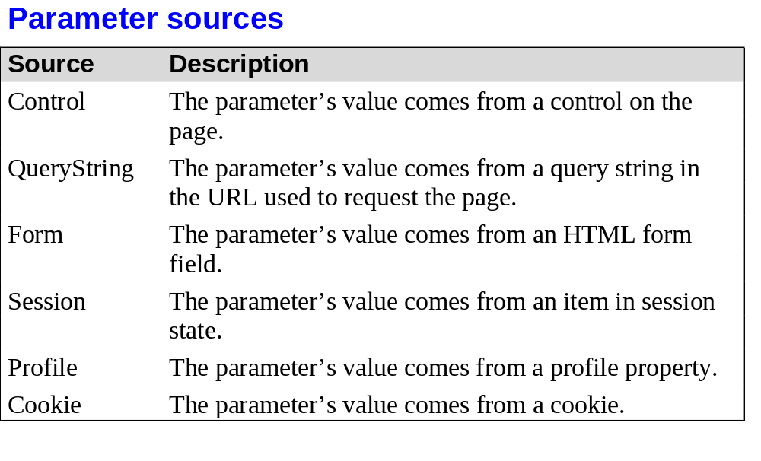
© 2011, Mike Murach & Associates, Inc.
Slide <number>

Slide 20
SqlDataSource that defines a SELECT command
<asp:SqlDataSource ID="sourceEmployees" runat="server"
ProviderName="System.Data.SqlClient"
ConnectionString="<%$ ConnectionStrings:Northwind %>"
SelectCommand=
"SELECT EmployeeID, FirstName, LastName, Title, City FROM Employees"/>

Slide 21
Parameterized Commands
SqlDataSource markup
<asp:SqlDataSource ID="sourceEmployees" runat="server"
ProviderName="System.Data.SqlClient"
ConnectionString="<%$ ConnectionStrings:Northwind %>“
SelectCommand="SELECT EmployeeID, FirstName, LastName,
Title, City FROM Employees WHERE City=@City">
<SelectParameters>
<asp:ControlParameter ControlID="lstCities" Name="City"
PropertyName="SelectedValue" />
</SelectParameters>
</asp:SqlDataSource>
GridView that binds to the SqlDataSource
<asp:GridView ID="GridView1" runat="server" DataSourceID="sourceEmployees">
</asp:GridView>

Slide 22
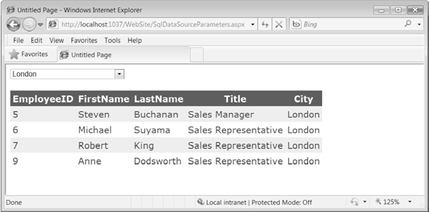
Selecting records based on control selection

Slide 23
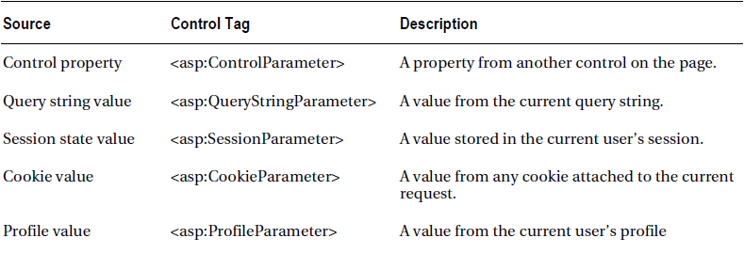
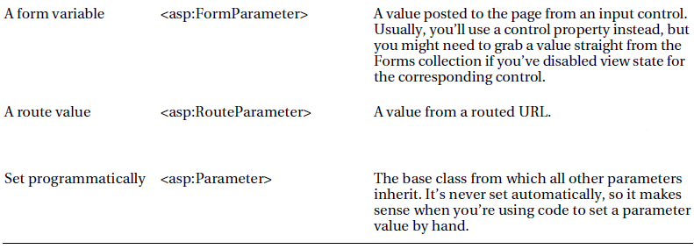
Parameter Types

Slide 24
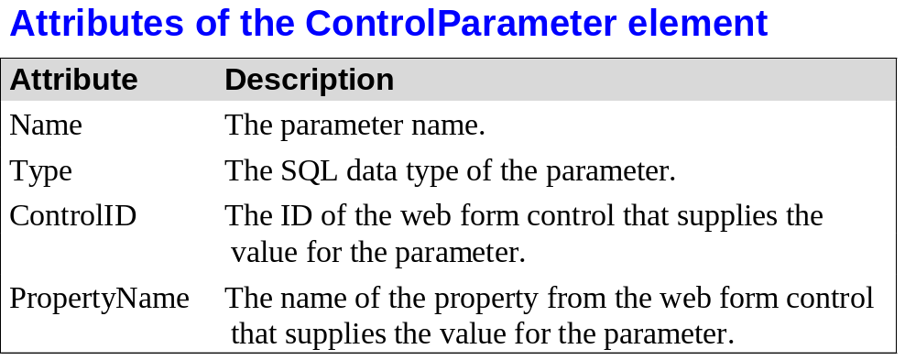
© 2011, Mike Murach & Associates, Inc.
Slide <number>

Slide 25
Example
Demo – QueryParameter1.aspx
Define a list control that shows all the available cities in the first page
<asp:SqlDataSource ID="sourceEmployeeCities" runat="server"
ProviderName="System.Data.SqlClient"
ConnectionString="<%$ ConnectionStrings:Northwind %>"
SelectCommand="SELECT DISTINCT City FROM Employees">
</asp:SqlDataSource>
<asp:ListBox ID="lstCities" runat="server" DataSourceID="sourceEmployeeCities"
DataTextField="City"></asp:ListBox><br />

Slide 26
After selecting the city …
Copy the selected city to the query string and redirect the page
  Protected Sub cmdGo_Click(ByVal sender As Object, ByVal e As System.EventArgs
  ) Handles cmdGo.Click
  Response.Redirect("QueryParameter2.aspx?city=" & lstCities.SelectedValue)
  End Sub

Slide 27
Bind the GridView according to the city value in the next page
<asp:SqlDataSource ID="sourceEmployees" runat="server"
ProviderName="System.Data.SqlClient"
ConnectionString="<%$ ConnectionStrings:Northwind %>"
SelectCommand="GetEmployeesByCity" SelectCommandType="StoredProcedure">
<SelectParameters>
<asp:QueryStringParameter Name="City" QueryStringField="city" />
</SelectParameters>
</asp:SqlDataSource>

Slide 28
Markup for the GridView
<asp:GridView ID="GridView1" runat="server" DataSourceID="sourceEmployees">
</asp:GridView>

Slide 29
StoredProcedure
CREATE PROCEDURE [dbo].[GetEmployeesByCity]
@City nvarchar(15)
AS
SELECT * FROM [Employees] WHERE ([City] = @City)
RETURN 0
[Note: If the stored procedure is not in the database then you need to create it.]
Murach’s ASP.NET 4/C#, C13
© 2011, Mike Murach & Associates, Inc.
Slide <number>

Slide 30
Modifying a parameter value before using
Events that are designed for this purpose
  Selecting
  Updating
  Deleting
  Inserting

Slide 31
Example
Protected Sub sourceEmployees_Selecting(
ByVal sender As Object, ByVal e As SqlDataSourceSelectingEventArgs
) Handles sourceEmployees.Selecting
If DirectCast(e.Command.Parameters("@City").Value, String) =
"(Choose a City)" Then
' Do nothing.
e.Cancel = True
ElseIf DirectCast(e.Command.Parameters("@City").Value, String) =
"(All Cities)" Then
' Manually change the command.
e.Command.CommandText = "SELECT * FROM Employees"
End If
End Sub

Slide 32
Handling Errors
Handle the data source event that occurs immediately after the error such as the Selected, Updated, Deleted, or Inserted events
Access the exception object through the SqlDataSourceStatusEventArgs.Exception property
Set SqlDataSourceStatusEventArgs.ExceptionHandled property to true to prevent the error from spreading any further

Slide 33
Example
Protected Sub sourceEmployees_Selected(ByVal sender As Object, ByVal e As SqlDataSourceStatusEventArgs
) Handles sourceEmployees.Selected
If e.Exception IsNot Nothing Then
' Mask the error with a generic message (for security purposes).
lblError.Text = "An exception occurred performing the query."
' Consider the error handled.
e.ExceptionHandled = True
End If
End Sub

Slide 34
Updating Records
SqlDataSource that defines a basic update command that updates every field
  <asp:SqlDataSource ID="sourceEmployees" runat="server"
  ProviderName="System.Data.SqlClient"
  ConnectionString="<%$ ConnectionStrings:Northwind %>"
  SelectCommand="SELECT EmployeeID, FirstName, LastName, Title, City FROM Employees"
  UpdateCommand="UPDATE Employees SET FirstName=@FirstName, LastName=@LastName,
  Title=@Title, City=@City FROM Employees WHERE EmployeeID=@EmployeeID">
  </asp:SqlDataSource>
(Note: As long as you give each parameter the same name as the field it affects and preface it with the @ symbol (so FirstName becomes @FirstName), you don’t need to define the parameter)

Slide 35
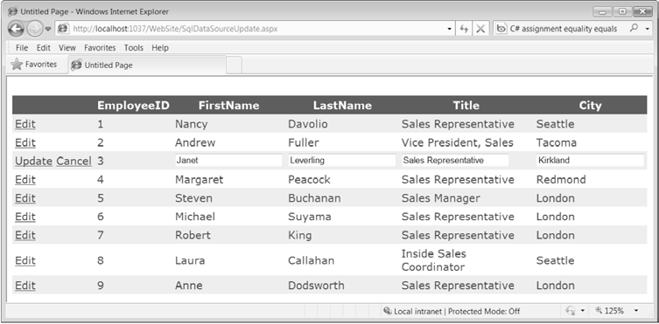
Editing with the GridView

Slide 36
Parameter name is different from the field name
Need to define the parameter
<asp:SqlDataSource ID="sourceEmployees" runat="server" ProviderName="System.Data.SqlClient"
ConnectionString="<%$ ConnectionStrings:Northwind %>"
SelectCommand="SELECT EmployeeID, FirstName, LastName, Title, City FROM Employees"
UpdateCommand="UPDATE Employees SET FirstName=@FName, LastName=@LastName, Title=@Title, City=@City FROM Employees WHERE EmployeeID=@EmployeeID">
<UpdateParameters>
<asp:Parameter Name="FName" DbType="String" />
</UpdateParameters>
</asp:SqlDataSource>
Murach’s ASP.NET 4/C#, C13
© 2011, Mike Murach & Associates, Inc.
Slide <number>

Slide 37
Using TemplateField
<asp:GridView ID="GridView1" runat="server" DataSourceID="sourceEmployees" … >
<Columns>
<asp:BoundField DataField="EmployeeID" HeaderText="EmployeID" ReadOnly="True"/>
<asp:TemplateField HeaderText="FirstName">
<EditItemTemplate>
<asp:TextBox ID="txtFirstName" runat="server" Text='<%# Bind("FirstName") %>'></asp:TextBox>
</EditItemTemplate>
<ItemTemplate>
<asp:Label ID="Label1" runat="server" Text='<%# Bind("FirstName") %>'></asp:Label>
</ItemTemplate>
</asp:TemplateField>
Slide <number>

Slide 38
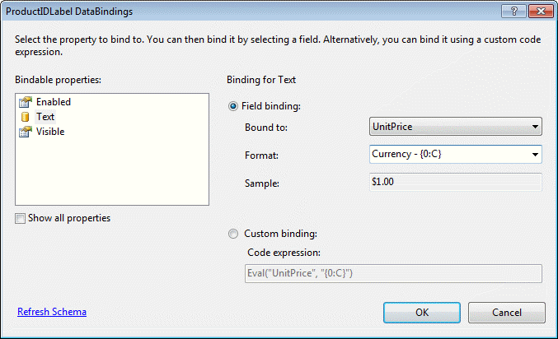
© 2011, Mike Murach & Associates, Inc.
Slide <number>

Slide 39
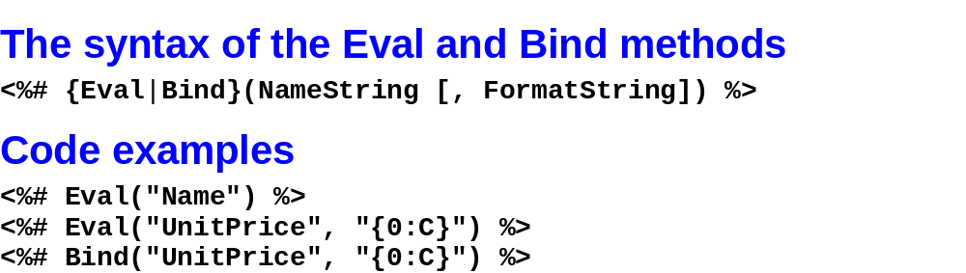
© 2011, Mike Murach & Associates, Inc.
Slide <number>

Slide 40
Setting the parameter value during the updating event
Protected Sub sourceEmployees_Updating(sender As Object, e As SqlDataSourceCommandEventArgs) Handles sourceEmployees.Updating
e.Command.Parameters("@FName").Value = CType(GridView1.Rows(GridView1.EditIndex).FindControl("txtFirstName"), TextBox).Text
End Sub
GridView1.EditIndex provides the index of the row that is being edited.
FindControl is used to locate the control.
Murach’s ASP.NET 4/C#, C13
© 2011, Mike Murach & Associates, Inc.
Slide <number>

Slide 41
Strict Concurrency Checking
Performs the update only if every field matches
  UpdateCommand="UPDATE Employees SET FirstName=@FirstName, LastName=@LastName,
  Title=@Title, City=@City FROM Employees WHERE EmployeeID=@original_EmployeeID AND
  FirstName=@original_FirstName AND LastName=@original_LastName AND
  Title=@original_Title AND City=@original_City“
Need to set the SqlDataSource.ConflictDetection property to ConflictOptions.CompareAllValues instead of ConflictOptions.OverwriteChanges (the default)

Slide 42
SqlDataSource.OldValuesParameterFormatString property that takes a string that has a {0} placeholder, where {0} indicates the original parameter name

Slide 43

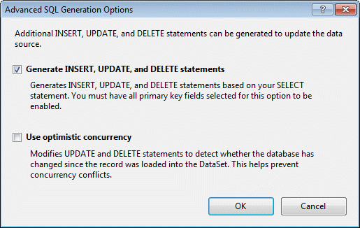
© 2011, Mike Murach & Associates, Inc.
Slide <number>

Slide 44
Checking for AffectedRows
Protected Sub sourceEmployees_Updated(sender As Object, e As SqlDataSourceStatusEventArgs) Handles sourceEmployees.Updated
If e.AffectedRows = 0 Then
lblMessage.Text = "No update was performed. " & _
"A concurrency error is likely, or the command is incorrectly written."
Else
lblMessage.Text = "Record successfully updated."
End If
End Sub
Murach’s ASP.NET 4/C#, C13
© 2011, Mike Murach & Associates, Inc.
Slide <number>

Slide 45
Example
<asp:SqlDataSource ID="sourceEmployees" runat="server"
ProviderName="System.Data.SqlClient"
ConnectionString="<%$ ConnectionStrings:Northwind %>"
SelectCommand=
"SELECT EmployeeID, FirstName, LastName, Title, City FROM Employees"
ConflictDetection="CompareAllValues"
OldValuesParameterFormatString="original_{0}"
UpdateCommand="UPDATE Employees SET FirstName=@FirstName, LastName=@LastName,
Title=@Title, City=@City FROM Employees WHERE EmployeeID=@original_EmployeeID
AND FirstName=@original_FirstName AND LastName=@original_LastName AND
Title=@original_Title AND City=@original_City">
</asp:SqlDataSource>

Slide 46
Updating with Stored Procedures
The UpdateCommand
  UpdateCommand="UpdateEmployee" UpdateCommandType="StoredProcedure“
UpdateEmployee stored procedure
CREATE PROCEDURE UpdateEmployee
@EmployeeID int,
@TitleOfCourtesy varchar(25),
@Last varchar(20),
@First varchar(10)
AS
...

Slide 47
SqlDataSource.UpdateParameters
The FirstName and LastName fields map to parameters named @First and @Last
Add two parameters to the SqlDataSource.UpdateParameters collection
  <asp:SqlDataSource ID="sourceEmployees" runat="server"
  ProviderName="System.Data.SqlClient"
  ConnectionString="<%$ ConnectionStrings:Northwind %>" SelectCommand=
  "SELECT EmployeeID, FirstName, LastName, TitleOfCourtesy FROM Employees"
  UpdateCommand="UpdateEmployee" UpdateCommandType="StoredProcedure"
  OnUpdating="sourceEmployees_Updating" >
  <UpdateParameters>
  <asp:Parameter Name="First" Type="String" />
  <asp:Parameter Name="Last" Type="String" />
  </UpdateParameters>
  </asp:SqlDataSource>

Slide 48
<asp:GridView ID="GridView1" runat="server" DataSourceID="sourceEmployees" CellPadding="4"
Font-Names="Verdana" Font-Size="Small" ForeColor="#333333" GridLines="None"
DataKeyNames="EmployeeID" EnableSortingAndPagingCallbacks="True" PageSize="5"
AutoGenerateEditButton="True">
<FooterStyle BackColor="#990000" Font-Bold="True" ForeColor="White" />
<RowStyle BackColor="#FFFBD6" ForeColor="#333333" />
<PagerStyle BackColor="#FFCC66" ForeColor="#333333" HorizontalAlign="Center" />
<SelectedRowStyle BackColor="#FFCC66" Font-Bold="True" ForeColor="Navy" />
<HeaderStyle BackColor="#990000" Font-Bold="True" ForeColor="White" />
<AlternatingRowStyle BackColor="White" />
</asp:GridView>
Murach’s ASP.NET 4/C#, C13
© 2011, Mike Murach & Associates, Inc.
Slide <number>

Slide 49
SqlDataSource.Updating event
React to the SqlDataSource.Updating event
Set the value for the @First and @Last parameters and remove the @FirstName and @LastName parameters from sight
  Protected Sub sourceEmployees_Updating(
  ByVal sender As Object, ByVal e As SqlDataSourceCommandEventArgs
  ) Handles sourceEmployees.Updating
  e.Command.Parameters("@First").Value = e.Command.Parameters("@FirstName").Value
  e.Command.Parameters("@Last").Value = e.Command.Parameters("@LastName").Value
  e.Command.Parameters.Remove(e.Command.Parameters("@FirstName"))
  e.Command.Parameters.Remove(e.Command.Parameters("@LastName"))
  End Sub

Slide 50
Deleting Records
Create a DeleteCommand that removes the record you want to delete
  <asp:SqlDataSource ID="sourceEmployees" runat="server"
  ProviderName="System.Data.SqlClient"
  ConnectionString="<%$ ConnectionStrings:Northwind %>"
  SelectCommand=
  "SELECT EmployeeID, FirstName, LastName, Title, City FROM Employees"
  DeleteCommand="DELETE Employees WHERE EmployeeID=@EmployeeID ">
  </asp:SqlDataSource>
Set the GridView.AutoGenerateDeleteButton property to true to add a column that shows a link named Delete next to each record
[Note: If you’re using the standard ConflictDetection (ConflictOptions.OverwriteChanges), you also need to set the GridView.DataKeyNames with a comma-separated list of the field names that make up the primary key]
Markup for the GridView
  <asp:GridView ID="GridView1" runat="server" DataSourceID="sourceEmployees"
  AutoGenerateDeleteButton="true" DataKeyNames="EmployeeID">
  </asp:GridView>

Slide 51
Inserting Records
Supported by DetailsView and FormView but not GridView
Define the InsertCommand
  <asp:SqlDataSource ID="sourceEmployees" runat="server"
  ProviderName="System.Data.SqlClient"
  ConnectionString="<%$ ConnectionStrings:Northwind %>"
  SelectCommand=
  "SELECT EmployeeID, FirstName, LastName, Title, City FROM Employees"
  InsertCommand="INSERT INTO Employees (FirstName,LastName,Title,City)
  VALUES (@FirstName,@LastName,@Title,@City)">
  </asp:SqlDataSource>
ConflictDetection and OldValuesParameterFormatString properties have no effect when inserting records
Configure the bound data control to support insertion
  <asp:DetailsView ID="DetailsView1" runat="server"
  DataSourceID="sourceEmployees" AutoGenerateInsertButton="true">
  </asp:DetailsView>

Slide 52
Disadvantages of the SqlDataSource
Data access logic embedded in the page
Maintenance in large applications
Lack of flexibility
Inapplicability to other data tasks
[Note: consider the ObjectDataSource that allows you to bind your page to a custom data access component with design-time data binding and no need to write code in the web page]

